Slide 1
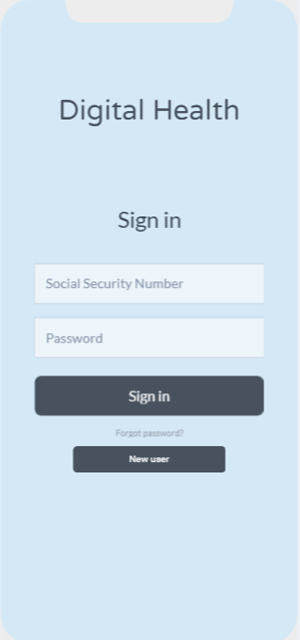
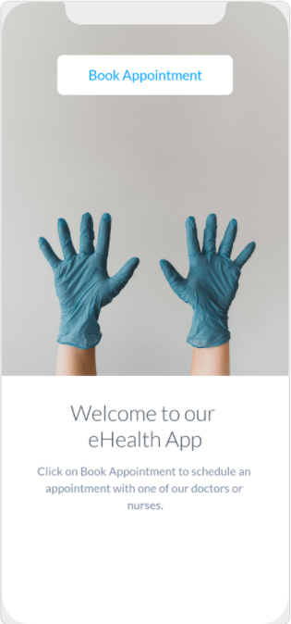
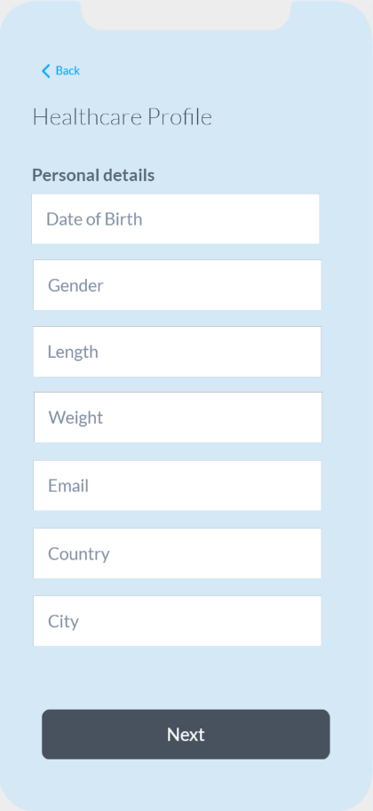
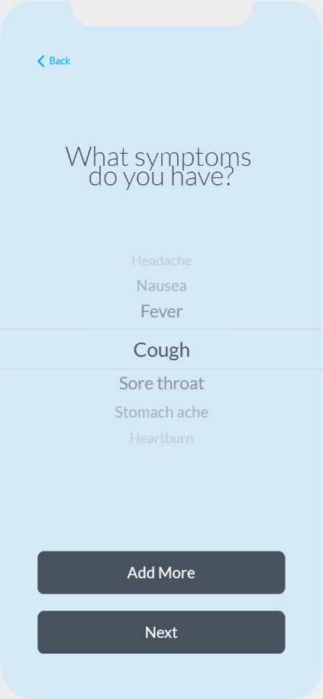
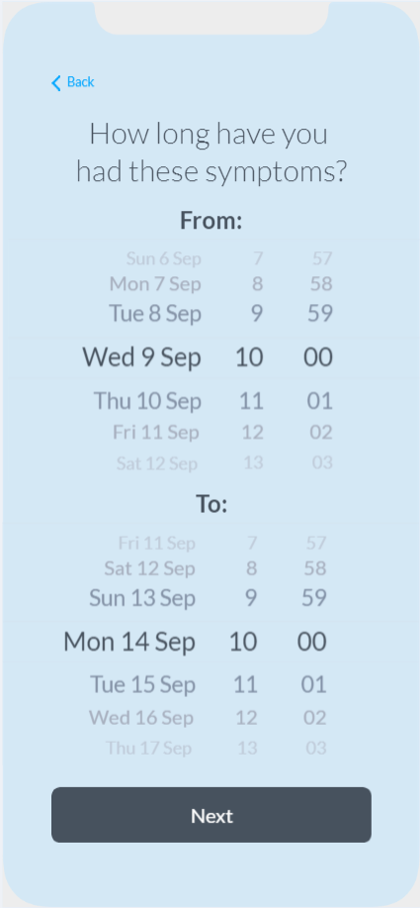
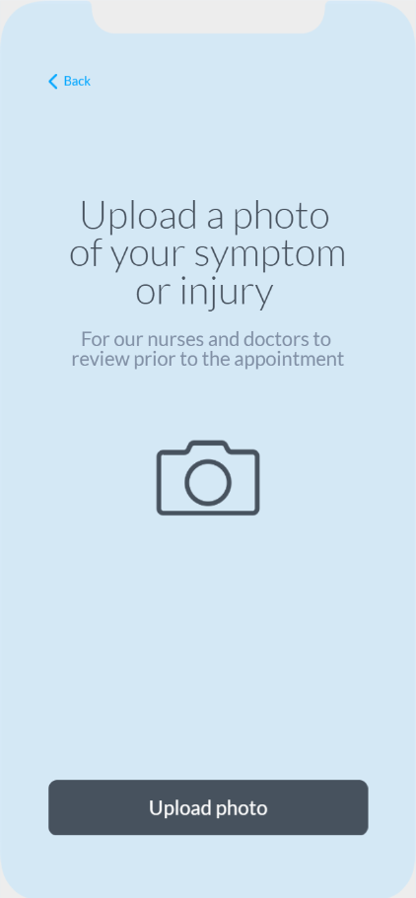
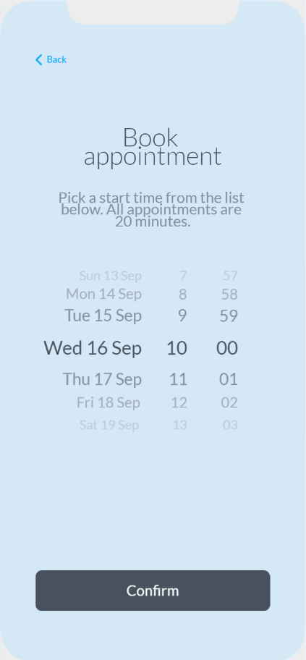
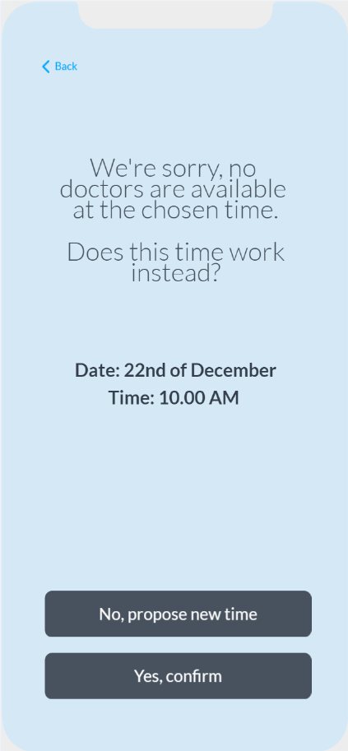
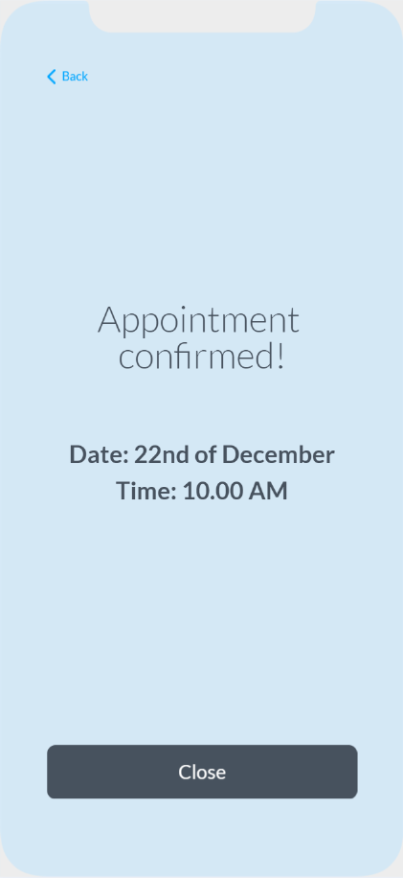
User Journey: Appointment Booking Process
This journey allows the patient to book a doctor's appointment in the app.
1
User Login
Enter social security number and password and click ”Sign in”
2
Home Screen
Click on ”Book Appointment”
3
Healthcare Profile
Enter personal details and click ”Next”
4
What Symptoms
Choose one symptom from the list. Click ”Add More” if needed
5
Time with Symptoms
Fill in start-date and time and end-date and time
6
Upload Photo
Click on ”Upload photo” to upload a photo
7
Pick a Time
Choose a suitable time for your appointment
8
No Timeslots Available
Confirm time or ask for a new time proposal
9
Appointment Confirmed
The appointment is now confirmed

